Slide 1
GAMEPLAN
BIBLICAL STRATEGIES
FOR A
HEALTHY LIFE

Slide 3
Serving With Urgency
GAMEPLAN

Slide 4
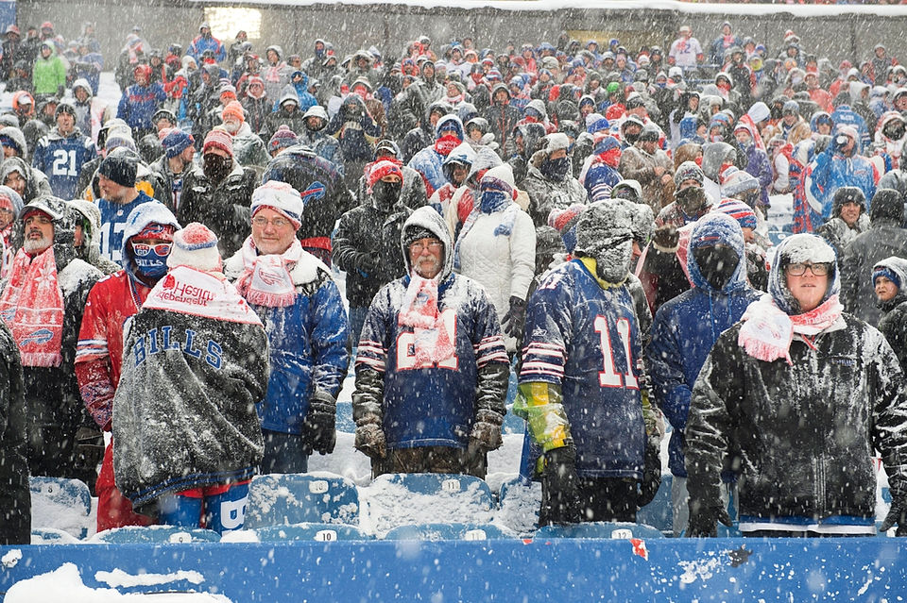

Slide 5
1. Serving Creates Community
GAMEPLAN

Slide 6
2. In Serving we follow the example of the believers who have gone before us
GAMEPLAN

Slide 7
3. In Serving we follow the example of Jesus
GAMEPLAN

Slide 8
4. Serving brings great JOY
GAMEPLAN

Slide 9
Write out your GAME PLAN for 2018
1. Setting goals for our quiet time
2. Setting goals for our WORSHIP
3. Setting goals for Small Group
4. Setting goals for Serving
What are my spiritual gifts
What do I love doing
What area am I feeling called to serve in
Sign up
GAMEPLAN

Slide 10
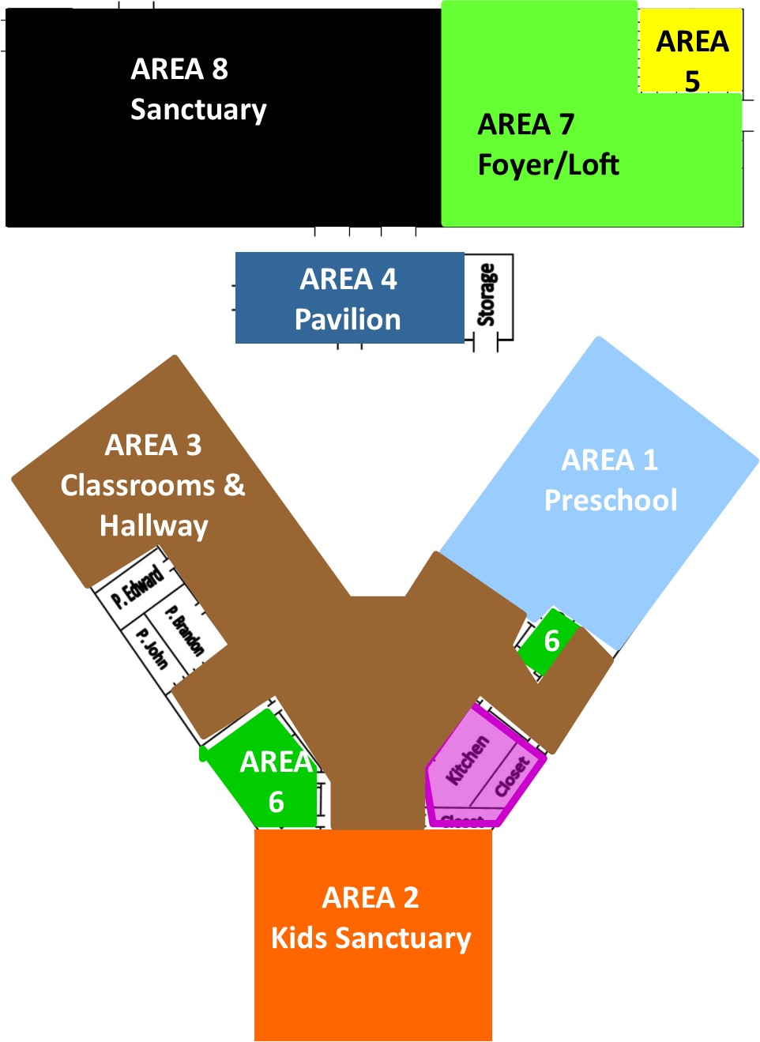

Slide 11
