Slide 2
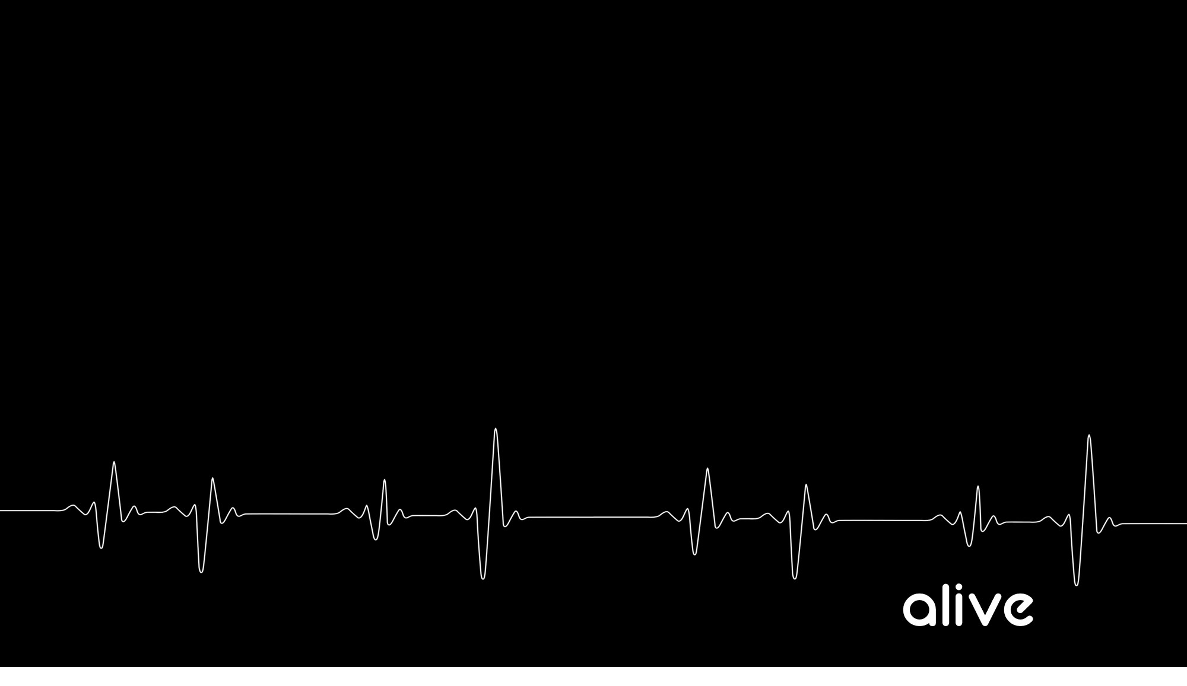
The Possession Of A Resurrection Attitude

Slide 3
Justification - The instantaneous legal act of God by His grace (not by our works or merit) in which he (1) thinks of our sins as forgiven and Christ's righteousness as belonging to us, and (2) declares us to be righteous in his sight. - Our sins are laid on Jesus, His righteousness is laid on us (The sin that Jesus did not commit is put on Him, and the righteousness that we did not perform is put on us.

Slide 4
Sanctification = The progressive lifelong work of God the Holy Spirit and the regenerate believer that makes us more and more free from sin and more and more like Christ in our actual lives. The act of making holy. The act of God's grace by which the affections of men are alienated from sin and the world, and exalted to a supreme love to God.

Slide 5
1. Our celebration of GRACE should never lead us to an abuse of GRACE

Slide 6
2. A true believer has died to sin

Slide 7
3. A true believer has been IMMERSED into Jesus’ death

Slide 8
4. A True believer has been BURIED with Jesus through SPIRITUAL baptism

Slide 9
5. If we are united with Jesus in His death then we are Alive with Jesus in His resurrection

Slide 10
2 Corinthians 13:4 For indeed He was crucified because of weakness, yet He lives because of the power of God. For we also are weak in Him, yet we will live with Him because of the power of God directed toward you.

Slide 11
2 Corinthians 5:17 Therefore if anyone is in Christ, he is a new creature; the old things passed away; behold, new things have come.

Slide 12
Ephesians 4:24 Put on the new self, which in the likeness of God has been created in righteousness and holiness of the truth.

Slide 13
Colossians 3:9–10 Do not lie to one another, since you laid aside the old self with its evil practices, 10 and have put on the new self who is being renewed to a true knowledge according to the image of the One who created him.

Slide 14
Ephesians 1:18–20 I pray that the eyes of your heart may be enlightened, so that you will know what is the hope of His calling, what are the riches of the glory of His inheritance in the saints, 19 and what is the surpassing greatness of His power toward us who believe. These are in accordance with the working of the strength of His might 20 which He brought about in Christ, when He raised Him from the dead and seated Him at His right hand in the heavenly places

Slide 15
6. We are now ALIVE TO GOD and free from sin’s dominance

