Slide 2
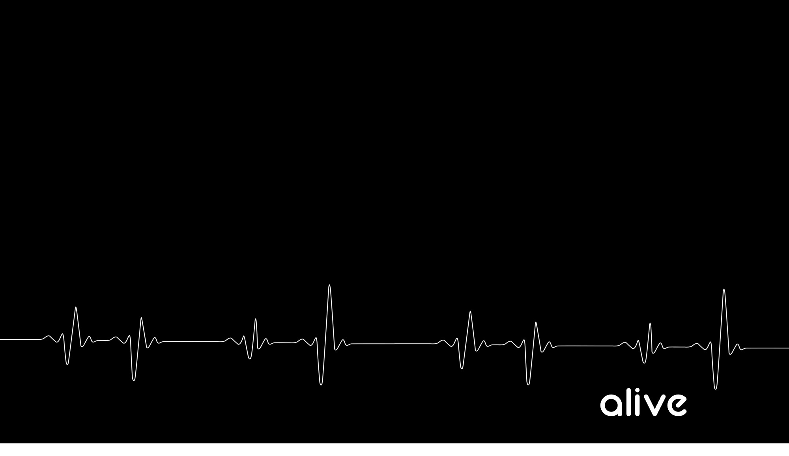
1. There is now no condemnation for those who are in Christ Jesus

Slide 3
2. We are now under the authority of the “law of the Spirit of Life in Christ Jesus”

Slide 4
3. The Law could not do what Jesus did

Slide 5
4. What is your mind set upon?

Slide 6
4. What is your mind set upon?

Slide 7
5. The mind set on the FLESH is death

Slide 8
6. The mind set on the SPIRIT is LIFE AND PEACE

Slide 9
7. The Spirit of Him who raised Jesus from the dead dwells in you

Slide 10
8. The Holy Spirit will give LIFE to our mortal bodies

Slide 11
9. The power of the Holy Spirit enables us to “put to death the deeds of the body”

Slide 12
How Do We Put The Deeds Of The Body To Death?

Slide 13
How Do We Put The Deeds Of The Body To Death?
a. Not by the FLESH. – (The flesh cannot overcome the flesh)

Slide 14
How Do We Put The Deeds Of The Body To Death?
b. What are the deed of the body (FLESH)?

Slide 15
Galatians 5:19–21 Now the deeds of the flesh are evident, which are: immorality, impurity, sensuality, 20 idolatry, sorcery, enmities, strife, jealousy, outbursts of anger, disputes, dissensions, factions, 21 envying, drunkenness, carousing, and things like these, of which I forewarn you, just as I have forewarned you, that those who practice such things will not inherit the kingdom of God.

Slide 16
1. Immorality 2. impurity 3. sensuality 4. idolatry, 5. sorcery 6. enmities 7. strife 8. jealousy 9.outbursts of anger 10. disputes 11. dissensions 12. factions 13. envying 14. drunkenness 15.carousing 16. and things like these

Slide 17
1 Corinthians 6:9 9 Or do you not know that the unrighteous will not inherit the kingdom of God? Do not be deceived; neither fornicators, nor idolaters, nor adulterers, nor effeminate, nor homosexuals.

Slide 18
1 Corinthians 5:11–13 But actually, I wrote to you not to associate with any so-called brother if he is an immoral person, or covetous, or an idolater, or a reviler, or a drunkard, or a swindler—not even to eat with such a one. 12 For what have I to do with judging outsiders? Do you not judge those who are within the church? 13 But those who are outside, God judges. Remove the wicked man from among yourselves.

Slide 19
1. Immorality 2. impurity 3. sensuality 4. idolatry, 5. sorcery 6. enmities 7. strife 8. jealousy 9.outbursts of anger 10. disputes 11. dissensions 12. factions 13. envying 14. drunkenness 15.carousing 16. and things like these

Slide 20
Colossians 3:5–6 Therefore consider the members of your earthly body as dead to immorality, impurity, passion, evil desire, and greed, which amounts to idolatry. 6 For it is because of these things that the wrath of God will come upon the sons of disobedience.

Slide 21
1. Immorality 2. impurity 3. sensuality 4. idolatry, 5. sorcery 6. enmities 7. strife 8. jealousy 9.outbursts of anger 10. disputes 11. dissensions 12. factions 13. envying 14. drunkenness 15.carousing 16. and things like these

Slide 22
Mark 7:20–23 And He was saying, “That which proceeds out of the man, that is what defiles the man. 21 “For from within, out of the heart of men, proceed the evil thoughts, fornications, thefts, murders, adulteries, 22 deeds of coveting and wickedness, as well as deceit, sensuality, envy, slander, pride and foolishness. 23 “All these evil things proceed from within and defile the man.”

Slide 23
1. Immorality 2. impurity 3. sensuality 4. idolatry, 5. sorcery 6. enmities 7. strife 8. jealousy 9.outbursts of anger 10. disputes 11. dissensions 12. factions 13. envying 14. drunkenness 15.carousing 16. and things like these

Slide 24
1. Immorality 2. impurity 3. sensuality 4. idolatry, 5. sorcery 6. enmities 7. strife 8. jealousy 9.outbursts of anger 10. disputes 11. dissensions 12. factions 13. envying 14. drunkenness 15.carousing 16. and things like these

Slide 25
Revelation 21:7–8 “He who overcomes will inherit these things, and I will be his God and he will be My son. 8 “But for the cowardly and unbelieving and abominable and murderers and immoral persons and sorcerers and idolaters and all liars, their part will be in the lake that burns with fire and brimstone, which is the second death.”

Slide 26
1. Immorality 2. impurity 3. sensuality 4. idolatry, 5. sorcery 6. enmities 7. strife 8. jealousy 9.outbursts of anger 10. disputes 11. dissensions 12. factions 13. envying 14. drunkenness 15.carousing 16. and things like these

Slide 27
1. Immorality 2. impurity 3. sensuality 4. idolatry, 5. sorcery 6. enmities 7. strife 8. jealousy 9.outbursts of anger 10. disputes 11. dissensions 12. factions 13. envying 14. drunkenness 15.carousing 16. and things like these

Slide 28
2 Corinthians 12:20–21 For I am afraid that perhaps when I come I may find you to be not what I wish and may be found by you to be not what you wish; that perhaps there will be strife, jealousy, angry tempers, disputes, slanders, gossip, arrogance, disturbances; 21 I am afraid that when I come again my God may humiliate me before you, and I may mourn over many of those who have sinned in the past and not repented of the impurity, immorality and sensuality which they have practiced

Slide 29
1. Immorality 2. impurity 3. sensuality 4. idolatry, 5. sorcery 6. enmities 7. strife 8. jealousy 9.outbursts of anger 10. disputes 11. dissensions 12. factions 13. envying 14. drunkenness 15.carousing 16. and things like these

Slide 30
1. Immorality 2. impurity 3. sensuality 4. idolatry, 5. sorcery 6. enmities 7. strife 8. jealousy 9.outbursts of anger 10. disputes 11. dissensions 12. factions 13. envying 14. drunkenness 15.carousing 16. and things like these

Slide 31
1. Immorality 2. impurity 3. sensuality 4. idolatry, 5. sorcery 6. enmities 7. strife 8. jealousy 9.outbursts of anger 10. disputes 11. dissensions 12. factions 13. envying 14. drunkenness 15.carousing 16. and things like these

Slide 32
1. Immorality 2. impurity 3. sensuality 4. idolatry, 5. sorcery 6. enmities 7. strife 8. jealousy 9.outbursts of anger 10. disputes 11. dissensions 12. factions 13. envying 14. drunkenness 15.carousing 16. and things like these

Slide 33
1. Immorality 2. impurity 3. sensuality 4. idolatry, 5. sorcery 6. enmities 7. strife 8. jealousy 9.outbursts of anger 10. disputes 11. dissensions 12. factions 13. envying 14. drunkenness 15.carousing 16. and things like these

Slide 34
1. Immorality 2. impurity 3. sensuality 4. idolatry, 5. sorcery 6. enmities 7. strife 8. jealousy 9.outbursts of anger 10. disputes 11. dissensions 12. factions 13. envying 14. drunkenness 15.carousing 16. and things like these

Slide 35
1. Immorality 2. impurity 3. sensuality 4. idolatry, 5. sorcery 6. enmities 7. strife 8. jealousy 9.outbursts of anger 10. disputes 11. dissensions 12. factions 13. envying 14. drunkenness 15.carousing 16. and things like these

Slide 36
1. Immorality 2. impurity 3. sensuality 4. idolatry, 5. sorcery 6. enmities 7. strife 8. jealousy 9.outbursts of anger 10. disputes 11. dissensions 12. factions 13. envying 14. drunkenness 15.carousing 16. and things like these

Slide 37
1. Immorality 2. impurity 3. sensuality 4. idolatry, 5. sorcery 6. enmities 7. strife 8. jealousy 9.outbursts of anger 10. disputes 11. dissensions 12. factions 13. envying 14. drunkenness 15.carousing 16. and things like these

Slide 38
How Do We Put The Deeds Of The Body To Death?
c. How does living according to the flesh kill us?

Slide 39
James 1:14–15 But each one is tempted when he is carried away and enticed by his own lust. 15 Then when lust has conceived, it gives birth to sin; and when sin is accomplished, it brings forth death.

Slide 40
How Do We Put The Deeds Of The Body To Death?
d. How do I put the deeds of the flesh to death?

Slide 41
1. Agree with God about sin (Any rationalization about whether or not it is sin will kill the process)
Hate sin
2. Immerse yourselves in the Word of God (The washing of His Word)
3. Yield yourselves to the will of the Holy Spirit
4. Refuse to practice the deeds of the flesh in the power of the Holy Spirit

