Slide 2
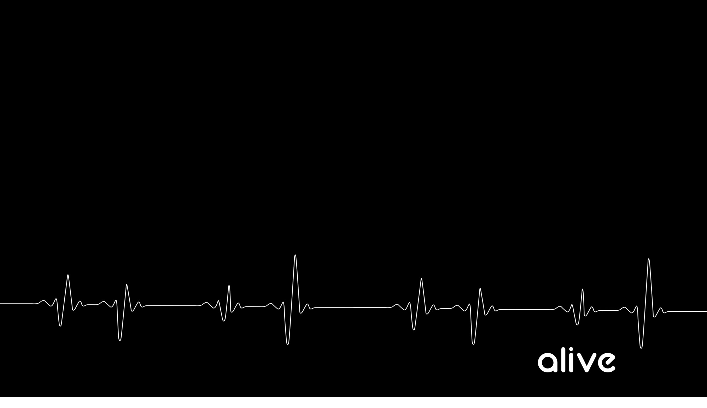
Justification - The instantaneous legal act of God by His grace (not by our works or merit) in which he (1) thinks of our sins as forgiven and Christ's righteousness as belonging to us, and (2) declares us to be righteous in his sight. - Our sins are laid on Jesus, His righteousness is laid on us (The sin that Jesus did not commit is put on Him, and the righteousness that we did not perform is put on us.

Slide 3
Sanctification = The progressive lifelong work of God the Holy Spirit and the regenerate believer that makes us more and more free from sin and more and more like Christ in our actual lives. The act of making holy. The act of God's grace by which the affections of men are alienated from sin and the world, and exalted to a supreme love to God.

Slide 4
1. Our celebration of GRACE should never lead us to an abuse of GRACE

Slide 5
2. A true believer has died to sin

Slide 6
3. A true believer has been IMMERSED into Jesus’ death

Slide 7
1 Corinthians 12:13 For by one Spirit we were all baptized into one body, whether Jews or Greeks, whether slaves or free, and we were all made to drink of one Spirit.

Slide 8
1 Corinthians 12:13 For by one Spirit we were all baptized into one body, whether Jews or Greeks, whether slaves or free, and we were all made to drink of one Spirit.

Slide 9
Galatians 3:27 For all of you who were baptized into Christ have clothed yourselves with Christ.

Slide 10
Matthew 3:11–12 “As for me, I baptize you with water for repentance, but He who is coming after me is mightier than I, and I am not fit to remove His sandals; He will baptize you with the Holy Spirit and fire.

Slide 11
1 Peter 3:21 21 Corresponding to that, baptism now saves you not the removal of dirt from the flesh, but an appeal to God for a good conscience—through the resurrection of Jesus Christ,

Slide 12
Galatians 2:20 “I have been crucified with Christ; and it is no longer I who live, but Christ lives in me; and the life which I now live in the flesh I live by faith in the Son of God, who loved me and gave Himself up for me.”

Slide 13
Romans 6:10 For the death that He died, He died to sin once for all; but the life that He lives, He lives to God.

Slide 14
Romans 6:11 Even so consider yourselves to be dead to sin, but alive to God in Christ Jesus.

Slide 15
2. A True believer has been BURIED with Jesus through a SPIRITUAL baptism.

Slide 16
Colossians 3:5 Therefore consider the members of your earthly body as dead to immorality, impurity, passion, evil desire, and greed, which amounts to idolatry.

Slide 17
1 Peter 2:24 He Himself bore our sins in His body on the cross, so that we might die to sin and live to righteousness; for by His wounds you were healed.

