Slide 1
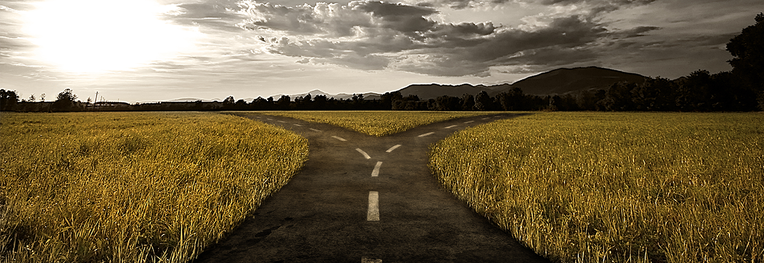
The Crossroads

Slide 2
The Road That Leads To DESTRUCTION &
The Road That Leads To LIFE

Slide 3
The Progression of A Futile Mind

Slide 4
The Steps Toward Destruction
Step 1 – They Suppress the truth in unrighteousness
Step 2 - They Dishonor God and Their Foolish Hearts Are Darkened
Step 3 – They Are Given Over (Abandoned) By God
Step 4 – They Know Better

Slide 5
Matthew 7:13–14 13 “Enter through the narrow gate; for the gate is wide and the way is broad that leads to destruction, and there are many who enter through it. 14 “For the gate is small and the way is narrow that leads to life, and there are few who find it.

Slide 6
1. Deeds that lead to DEATH

Slide 7
2. Step 5 – They Know Better

Slide 8
Psalm 1:1–6 How blessed is the man who does not walk in the counsel of the wicked, Nor stand in the path of sinners, Nor sit in the seat of scoffers! 2 But his delight is in the law of the Lord, And in His law he meditates day and night. 3 He will be like a tree firmly planted by streams of water, Which yields its fruit in its season And its leaf does not wither; And in whatever he does, he prospers. 4 The wicked are not so, But they are like chaff which the wind drives away. 5 Therefore the wicked will not stand in the judgment, Nor sinners in the assembly of the righteous. 6 For the Lord knows the way of the righteous, But the way of the wicked will perish.

