Slide 2
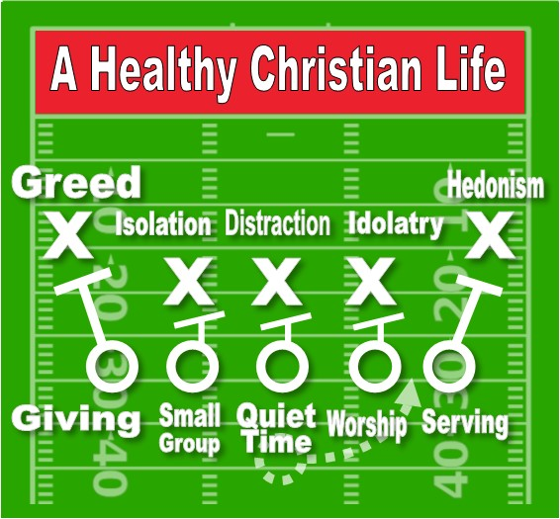

Slide 3
1. Tithing is Biblical
GAMEPLAN

Slide 4
Numbers 18:21 “To the sons of Levi, behold, I have given all the tithe in Israel for an inheritance, in return for their service which they perform, the service of the tent of meeting.
GAMEPLAN

Slide 5
Lev 27:30 Thus all the tithe of the land, of the seed of the land or of the fruit of the tree, is the Lord’s; it is holy to the Lord.
GAMEPLAN

Slide 6
Matthew 23:23 “Woe to you, scribes and Pharisees, hypocrites! For you tithe mint and dill and cummin, and have neglected the weightier provisions of the law: justice and mercy and faithfulness; but these are the things you should have done without neglecting the others.
GAMEPLAN

Slide 7
1 Corinthians 16:1–2 Now concerning the collection for the saints, as I directed the churches of Galatia, so do you also. 2 On the first day of every week each one of you is to put aside and save, as he may prosper, so that no collections be made when I come.
GAMEPLAN

Slide 8
2. Tithing is Beneficial
GAMEPLAN

Slide 9
Exodus 36:4–7 And all the skillful men who were performing all the work of the sanctuary came, each from the work which he was performing, ⁵ and they said to Moses, “The people are bringing much more than enough for the construction work which the Lord commanded us to perform.” ⁶ So Moses issued a command, and a proclamation was circulated throughout the camp, saying, “Let no man or woman any longer perform work for the contributions of the sanctuary.” Thus the people were restrained from bringing any more. ⁷ For the material they had was sufficient and more than enough for all the work, to perform it.
GAMEPLAN

Slide 10
Deuteronomy 14:23 “You shall eat in the presence of the Lord your God, at the place where He chooses to establish His name, the tithe of your grain, your new wine, your oil, and the firstborn of your herd and your flock, so that you may learn to fear the Lord your God always.
GAMEPLAN

Slide 11
3. Tithing is a blessing to the church, our community and the nations
GAMEPLAN

Slide 12
Deuteronomy 26:12 12 “When you have finished paying all the tithe of your increase in the third year, the year of tithing, then you shall give it to the Levite, to the stranger, to the orphan and to the widow, that they may eat in your towns and be satisfied.
GAMEPLAN

Slide 13
Deuteronomy 26:12 12 “When you have finished paying all the tithe of your increase in the third year, the year of tithing, then you shall give it to the Levite, to the stranger, to the orphan and to the widow, that they may eat in your towns and be satisfied.
GAMEPLAN

Slide 14
Deuteronomy 14:28–29 28 “At the end of every third year you shall bring out all the tithe of your produce in that year, and shall deposit it in your town. 29 “The Levite, because he has no portion or inheritance among you, and the alien, the orphan and the widow who are in your town, shall come and eat and be satisfied, in order that the Lord your God may bless you in all the work of your hand which you do.
GAMEPLAN

